Slide 1
Prof. Swati

Slide 2
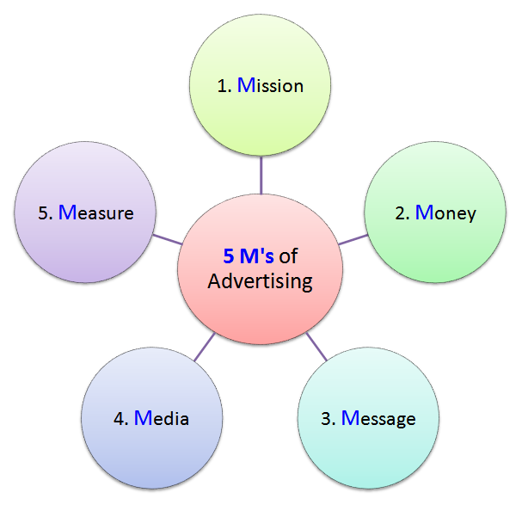
What is advertising??
The term advertising originates from the latin word “advertere” which means “to turn the mind towards”

Slide 3
DEFINITION OF ADVERTISING
The American Marketing Association defines advertising as” any paid form of non-personal presentation and promotion of ideas, goods or services by an identified sponsor”

Slide 4
Advertising
A shop wants to attract more customers or clear stocks, so it decides to offer special discounts for a period. It advertises in the daily newspapers to inform the public of its “sale”.
A company brings out a new product which is much more economical than the existing ones in its category. If the company cannot advertise the product, it would never be able to enter the market. Any other form of communication would be long drawn out and uneconomical.
The Government wants corporate, businessmen and salaried people to pay taxes. It advertises in newspapers, radio and television to reach the target audience.

Slide 5
Advertising
Advertising’s primary role is to create awareness to help sell products. In today’s time with global economic meltdown, advertising has to this in the most economical way.
Marketers are ever ready to tighten the noose around advertising and promotions budget and demands more bang for every buck spent.
Advertising agencies are expected to keep doing their job that they are best at i.e providing creative solutions – albeit at lower costs.

Slide 6
Who needs advertising?
Companies use advertising to:
inform people about their products and services
to make their brand names familiar to the public

Slide 7
Who needs advertising?
Companies use advertising to:
to make their brand names familiar to the public
However there are exceptions
New age/economy brands

Slide 8
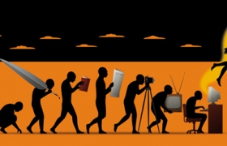
EVOLUTION OF ADVERTISING
Signs
Town Criers
Written advertisements
Introduction of printing press
Newspapers
Radio
TV
Ad agencies
Internet

Slide 9
Who needs advertising?
Companies use advertising to:
to give the company a “personality” which sets it apart from the others.
to remind customers about their brands at the right time and right place
to tell the public about improvements in products
to help their sales force to be more effective
to reinforce customer confidence in his/her purchase

Slide 10
Who needs advertising?
Governments and autonomous bodies use advertising to:
Inform people about their policies
Promote birth control
Educate the masses on health care
Prevent panic during natural disasters
Dispel harmful rumours
Attract foreign investment

Slide 11
Who needs advertising?
Public bodies prefer to use professional advertising agencies because agencies have the creative talent to explain complex issues in a way which makes them interesting, easy to understand and meaningful.

Slide 12
What is ADVERTISING?
“ the action of calling something to the attention of public”
WEBSTER’s Dictionary

Slide 13
How does advertising work?
Hierarchy of effects
100% target audience
75% aware of the product
50% show some interest in the product
30% preferred the product
25% tried the product
15% Repurchase

Slide 14
FEATURES OF ADVERTISING
Paid form of communication
Non-personal presentation
Provides publicity to goods/services
Identified sponsor
Provides information
Builds goodwill
Target oriented
Facilitates consumer choice
Art, science and profession
Creativity- the essence of advertising

Slide 15
Active participants in advertising
ADVERTISERS
ADVERTISING AGENCIES
AUDIENCE
ACTIVE PARTICIPANTS
ADVERTISING MEDIA
ADVERTISING PRODUCTION FIRMS
GOVERNMENT AUTHORITIES

Slide 16
Functions of advertising
Communicates the goods available
Motivates to buy
Reminder
Ensures conversion and loyalty
Provides mass appeal
Provides educative value
Informs new uses of the product
Persuasive approach

Slide 19
How does advertising work?
Action
THE AIDA CONCEPT
Desire
Interest
THE AIDA CONCEPT
Attention
Notes:
19

Slide 24
OVERVIEW OF ADVERTISING INDUSTRY IN INDIA
Television
Print media
Digital advertising
Radio
Films
Out-of-home

Slide 25
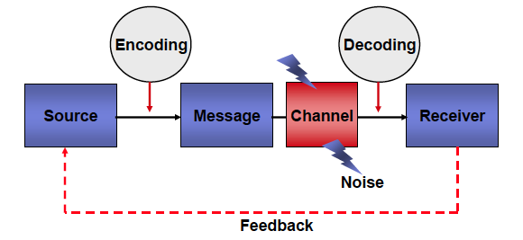
Communication Process

Slide 26
TRENDS IN ADVERTISING IN INDIA
Trends in Internet advertising
Trends in mobile advertising
Trends in web advertising
Trends in celebrity advertising
Trends in advertising through social sites
Trends in surrogate advertising
Viral advertising
Trends in Guerrilla advertising

Slide 27
CHALLENGES FACED BY ADVERTISERS IN INDIA
Higher transparency
Emergence of direct marketing
Serving rural markets
Change in readership
Change in viewership
Cultural changes
Rising cost of advertising
Inadequate attention to research
Multiplicity of media
Problem of clutters

Slide 28
Difference between advertising and publicity

